Slide 1
Practical Coding Series

Slide 2
Schedule
Dec 2
Style and Organization
Julia Wang
Jan 6
Elzar Batch System Usage
John Hover
Feb 3
Tensorflow
Amber Tang
Mar 3
Python Packages
Ammar
April 7
Optimizing for Performance and Speed
Batuhan Baserdan
May 5
Github Workflow
Rohit Tripathy

Slide 3

Note: this session is being recorded

Slide 4
Logistics
All materials will be available afterwards on Github
Please feel free to interrupt, intended to be interactive
We are catering to many levels, so if you have further questions afterward feel free to contact us

Slide 5
Style and Organization
Julia Wang

Slide 6
Outline
Why should we care??
Style Tips
Decomposition and Refactoring
File Organization
Testing
Questions and Time to Share

Slide 7
If you answered “know them but only kind of follow best practices”, why?
“You don’t run my life”
“Hard to claim anything is done “perfectly”. Also don’t necessarily agree with all official Python style rules.”
”sometimes I’m in a rush to get something working, and then don’t go back and re-format my code”
“Because it could be better. I’m sure I’m missing something.”

Slide 8
Why do we code?
To get results for publication
Want our results to be accurate
Better style -> easier to catch debug
To get people to read and cite our papers
Publish code on github
Hope that are project continues
Other people in the lab will read your code

Slide 9

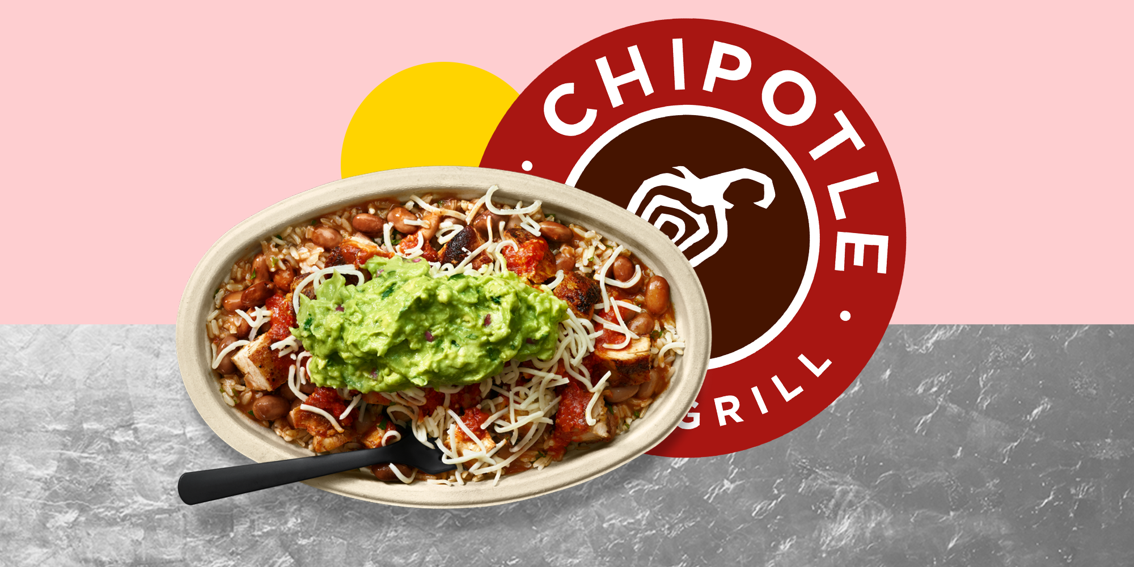
Why should we care?
READABILITY
MODULARITY

Slide 10
Readability
No one is going to read my code but me…
I’ll remember what I wrote…
READABILITY

Slide 11
Modularity
Pick and choose
Self-contained
MODULARITY

Slide 12
Style vs. Syntax
If you have bad syntax, your program will not run correctly
If you have bad style, your program will run, but not look pretty
Python: PEP8
Code Layout
Whitespace
Naming Conventions
Commenting

Slide 13
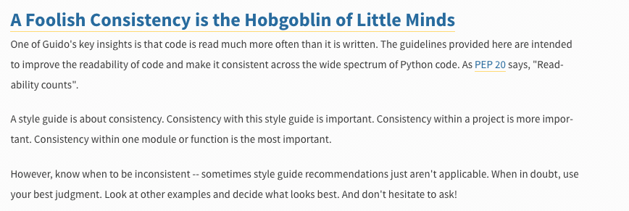
Style Guides: An excerpt from Python PEP8

Slide 14
Variable Naming
Do’s
camelCase or snake_case
variables = nouns
functions/methods = verbs
use long names - tab completion
Consistency!
Don’ts
one letter names
non-descriptive/ambiguous

Slide 15
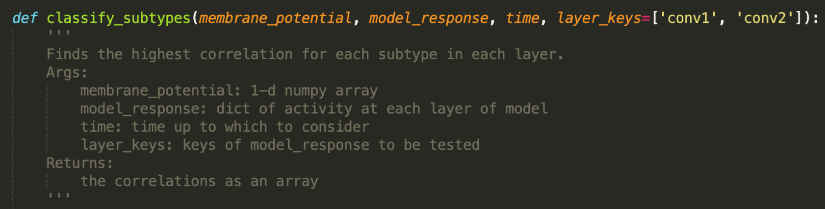
Commenting & docstrings
Comment sparingly and only to clarify
Your code should be readable enough that you don’t need to comment
If you update your code, update your comments
Docstrings:

Slide 16
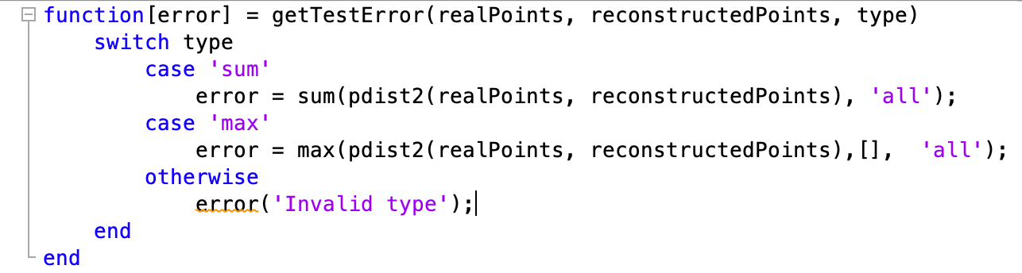
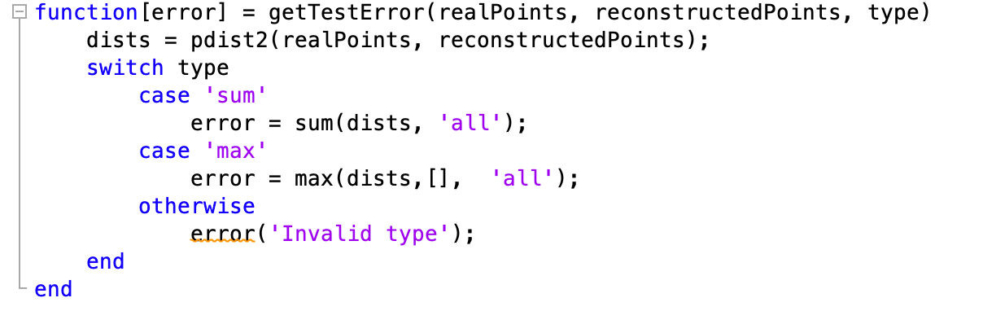
Variable Extraction

Slide 17
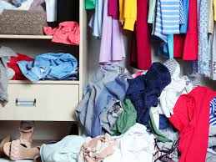
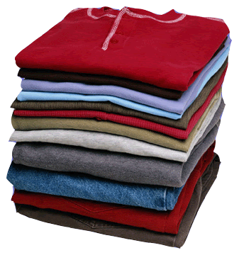
Decomposition and Refactoring

Slide 18
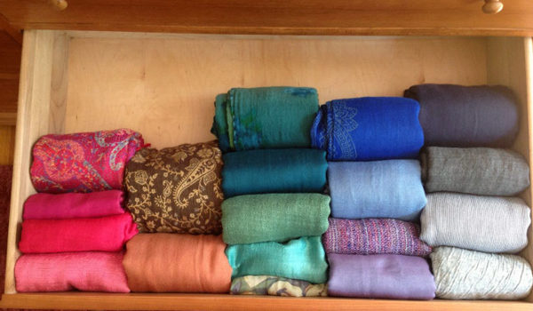

Decomposition and Refactoring

Slide 19
Decomposition and Refactoring
Decomposition is the splitting of larger functions into smaller functions
Refactoring is a fancy way of say reorganizing code

Slide 20
Decomposition: General Rules
One function, one goal
Functions should be readable within one page maximum
Don’t repeat code (even one liners)
Easier to call one line than to copy and paste
If you change it, you only need to change it once

Slide 21
Decomposition: Coding by Accretion
Writing out a plan can help you with how to decompose!
But too much structure can cause rigidity
Write self contained functions
Make the next step toward the current goal
Refactoring is an ongoing process

Slide 22

Decomposition: Example
Write a program called “Drive”:
Start the car, drive straight, turn right
def drive():
startCar()
driveStraight()
turnRight()

Slide 23

Decomposition: Example
New location: Bookstore
Start car, Drive straight, turn right, drive straight, turn left
driveToBookstore():
startCar()
driveStraight()
turnRight()
driveStraight()
turnLeft()
driveToChipotle()

Slide 24
Decomposition: Example
Later, we want to add the ability to turn left
def turnRight():
Turn Signal Right
Slow down
Steering Wheel Right
Two options:
turnLeft()
turn(direction=‘right’, ’left’)

Slide 25
Decomposition: Example
Drive(location):
startCar()
directions =getDirections(location)
for direction in directions: …
Structure that maps locations to directions

Slide 26
OOP vs. Functional Programming
Functional programming - passing data from function to function, never dependent on a global state
Object Oriented Programming – centered around classes and objects

Slide 27
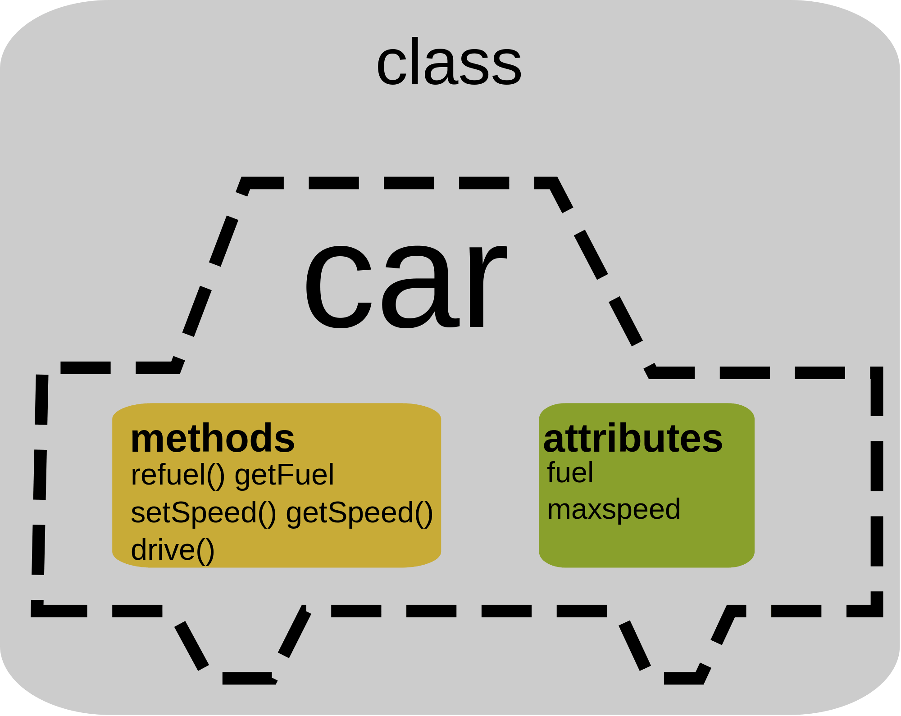
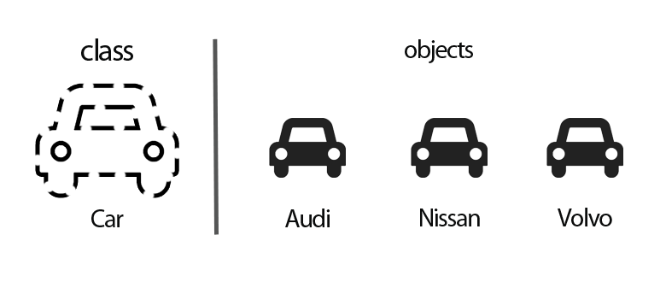
Object Oriented Programming
Classes provide a framework for defining objects with methods and attributes

Slide 28
When do I move to a class??
Collection of related functions that pass values back and forth
Think about objects literally -
Objects are nouns that have properties
Methods are verbs that can be done by or on those objects

Slide 29


IDEs and Text Editors
IDEs allow you to run code
TextEditors just edit text

Slide 30
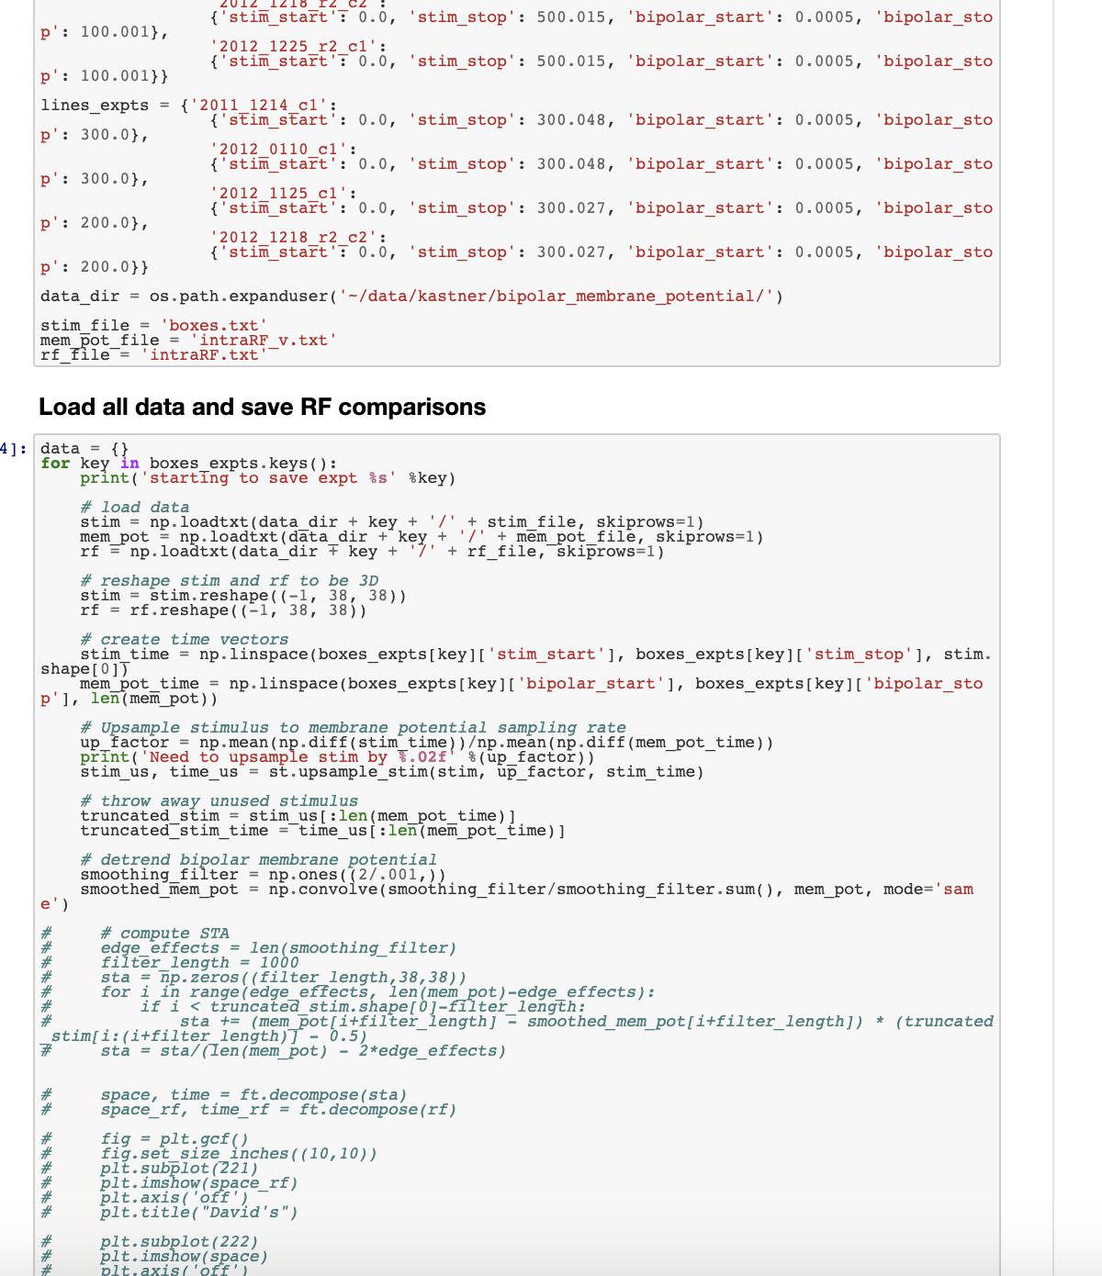
TIP: Don’t overuse jupyter!
Don’t put everything in a live script
Readability & modularity
Think about the next user or future you!

Slide 31
Example Workflow with Jupyter
Start experimenting in jupyter
Once I have a defined function, move that to a cell the top of the jupyter notebook
Move functions that are complete to a utils file that can be imported

Slide 32
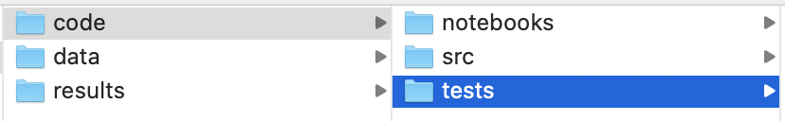
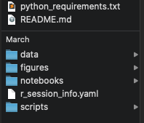
General Folder Structure

Slide 33
File Organization
Group related functions together
One class one file
Think about import structure
Loose functions can go into a utils

Slide 34
Testing
Test each function (modularity!)
Test edge cases
Add assert statements when appropriate
Asserting input parameters are of the right format

Slide 35
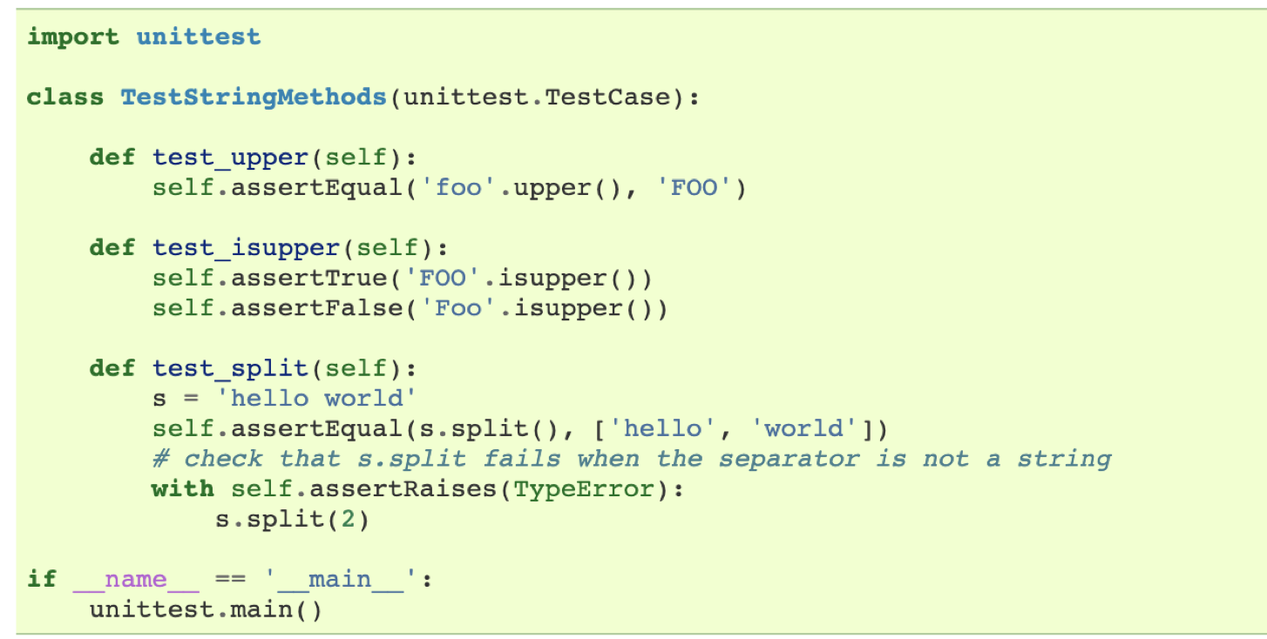
Unit Testing

Slide 36
Last Tips
Everyone has coding “imposter syndrome” – focus on readability & modularity
Google is your best friend
Spend more time reading than writing
Pay attention to how they structure their code
Don’t reinvent the wheel

Slide 37
Questions?

Slide 38
Example 1: Testing the median function
Let’s say you have a function that finds the median of a list of numbers
What are some cases you might want to test?

Slide 39
Example 2:OOP
Design 3 classes: Library, Book, Student
The Library should hold books.
Students and Books should have unique identifiers
Students should be able to check out books

